Slide 1
Capstone Project – Wyandotte County Data
Presented by
Hamza Khader Shaik Mohammed
1

Slide 2
Project Objective and Initial Project Synopsis
Project Objective: To determine any relation between health outcomes and minimum wage preemption across different states in US.
Initial Analysis: In 2023, a cohort of health-focused Kansas organizations undertook a study to determine the effects that state-level minimum wage preemption had on health.
Minimum wage preemption is when a higher level of government, like a state or federal government, blocks local governments from setting their own minimum wage rates.
2

Slide 3
Data Set
Features (Columns) :States, Preempted, Years, Years Ordered, Population, Alzheimer, Cardiovascular Disease, Respiratory Diseases, Cancer, Diabetes, Kidney Disease, Suicide, HIV, Firearm Mortality, Violent Crime Mortality, Drug Deaths, Obesity, Infant Mortality Rate, White perc, Black perc, Care Avoided due to Cost perc, Median Income, Income inequality, Housing Insecurity, Cost of Living Index, Child Mortality, Food Insecurity Perc, Current State Min Wage, Compared to Federal Wage, Annual Avg Temp
Records (Rows) : All 50 US states
Size : 250 x 30
3

Slide 4
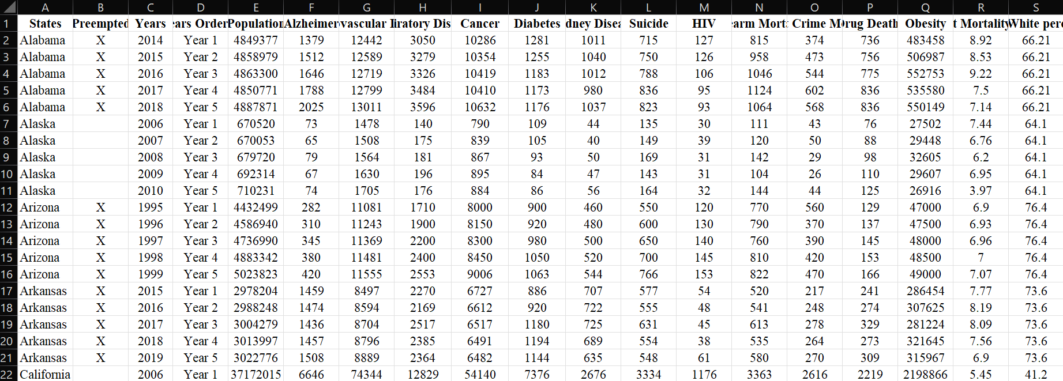
Data Set
6

Slide 5
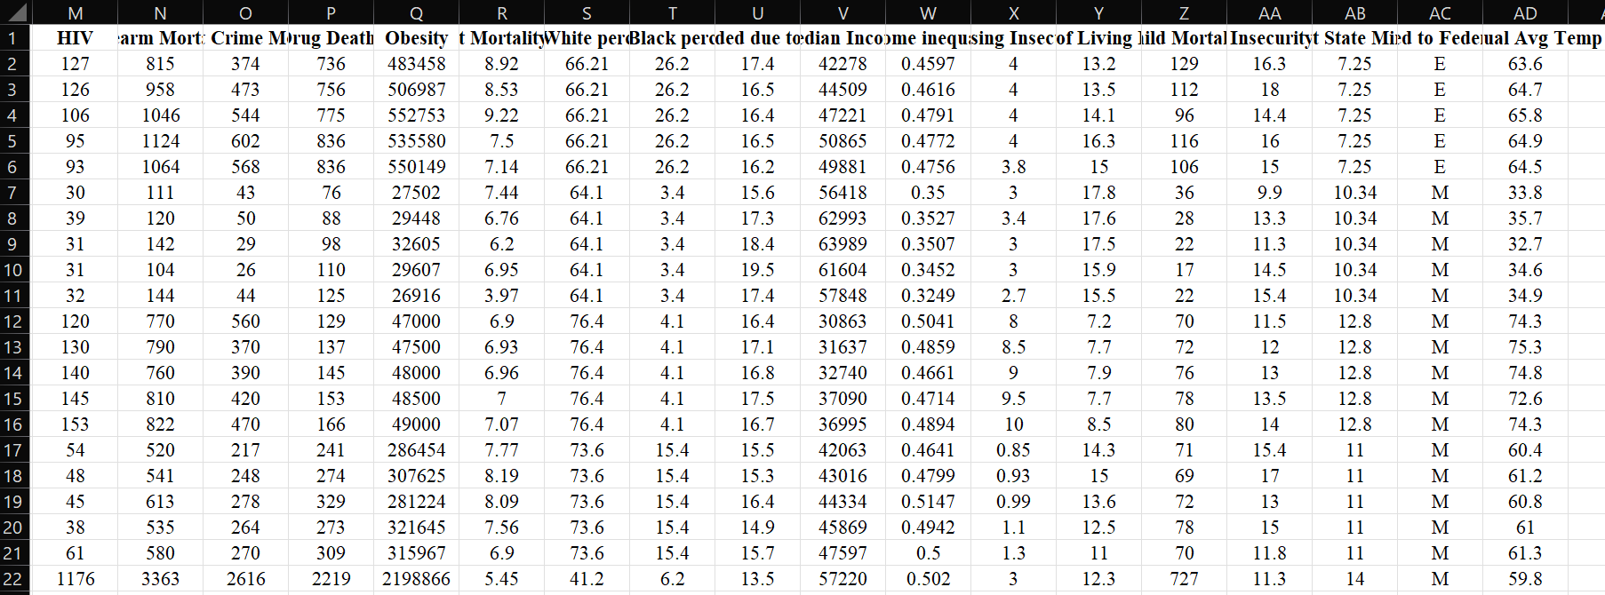
Data Set
5

Slide 6
Data scraping (Automation)
Libraries
fitz (PyMuPDF):
Used for opening and manipulating PDF files. It allows you to extract text and handle document operations.
re:
A built-in library in Python for working with regular expressions, allowing you to search for patterns in strings.
requests:
A popular library for making HTTP requests in Python, used to download files from the web.
Functions
download_pdf(url, save_path):
Downloads a PDF file from a specified URL and saves it to the given file path.
Parameters:
url: The URL of the PDF to download.
save_path: The local path where the PDF will be saved.
search_for_count(file_path, keyword):
Searches the specified PDF file for a keyword and extracts counts associated with it.
Parameters:
file_path: The path of the PDF file to search.
keyword: The term to search for in the document.
Returns: A list of dictionaries containing the page number, count found, and the context of the match.
Regex Pattern
Pattern Used: rf"{keyword}\s+(\d{{1,3}}(?:,\d{{3}})*)"
6

Slide 7
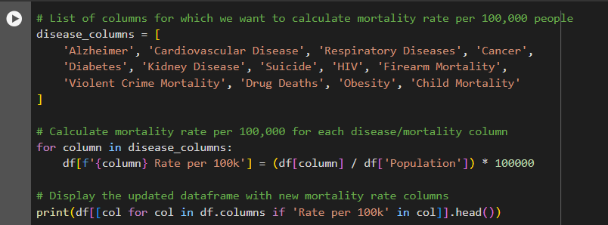
Standardizing and Transforming the Data Set
Using the population column in the data set to calculate the Rate per 100k values for the diseases and health outcomes.
Changed the “Preempted” column inputs to 1 for ‘X’ and 0 for NULL.
Transformed the “Compared to Federal Wage” into “State vs Federal Wage perc diff”, where the percentage difference is calculated between the State Minimum Wage and Federal Minimum Wage.
7

Slide 8
Standardized Data Set…
Features (Columns) :States, Preempted, Years, Years Ordered, Population, Alzheimer Rate per 100k, Cardiovascular Disease Rate per 100k, Respiratory Diseases Rate per 100k, Cancer Rate per 100k, Diabetes Rate per 100k, Kidney Disease Rate per 100k, Suicide Rate per 100k, HIV Rate per 100k, Firearm Mortality Rate per 100k, Violent Crime Mortality Rate per 100k, Drug Deaths Rate per 100k, Obesity Rate per 100k, Infant Mortality Rate, White perc, Black perc, Care Avoided due to Cost perc, Median Income, Income inequality, Housing Insecurity, Cost of Living Index, Child Mortality Rate per 100k, Food Insecurity Perc, Current State Min Wage, State vs Federal Wage perc diff, Annual Avg Temp
8

Slide 9
Project Approach…
5 Years of data Will be recorded for every feature and every state
Preempted Year – Median Year (3rd Year)
States without Preemption – median year – 2008 (3rd Year)
Analysis of the 5-year trend for all states
Change in Mortality rate, Economic and sociological issues
will determine whether the health outcomes have
improved or worsened.
9

Slide 10
Analytics Models
Correlations between health outcomes, preemption status and other factors e.g., racial composition, income levels, cost of living, etc.
Regression Analysis: Model health outcomes, economic and housing insecurities as a function of preemption status and other relevant factors over the 5-year period.
LSTM prediction and Analysis (for Socio-economic Outcomes)
Significance Testing for Preemption Effects To determine if health outcomes and socio-economic variables significantly differ between preempted and non-preempted states.
Hypothesis 1: Minimum wage preemption is associated with worse health outcomes (e.g., higher obesity, food insecurity, and infant mortality).
Hypothesis 2: Socio-economic inequalities, like income inequality and housing insecurity, are more pronounced in preempted states.
10

Slide 11
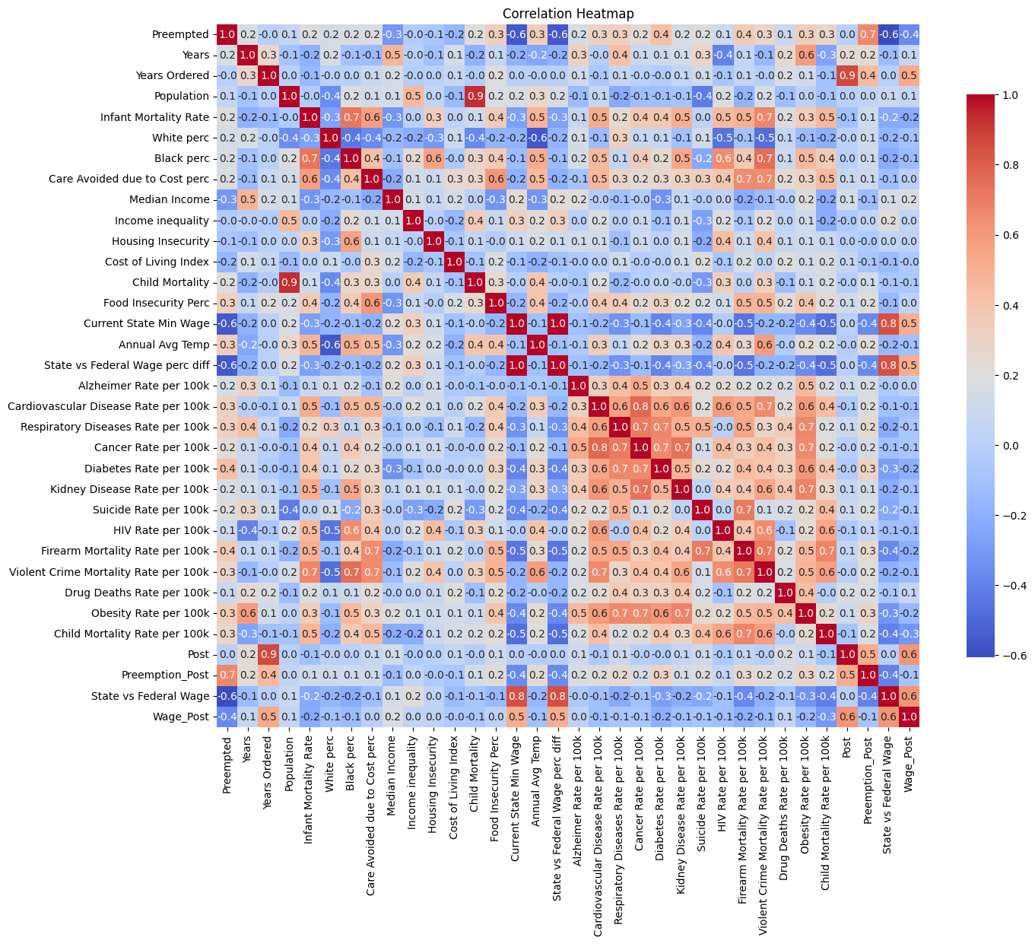
Correlation matrix
This shows us the correlation between different variables in the Data Set.
Correlation Coeff > +0.5 (Positive Correlation)
Correlation Coeff < -0.5 (Negative Correlation
11

Slide 12
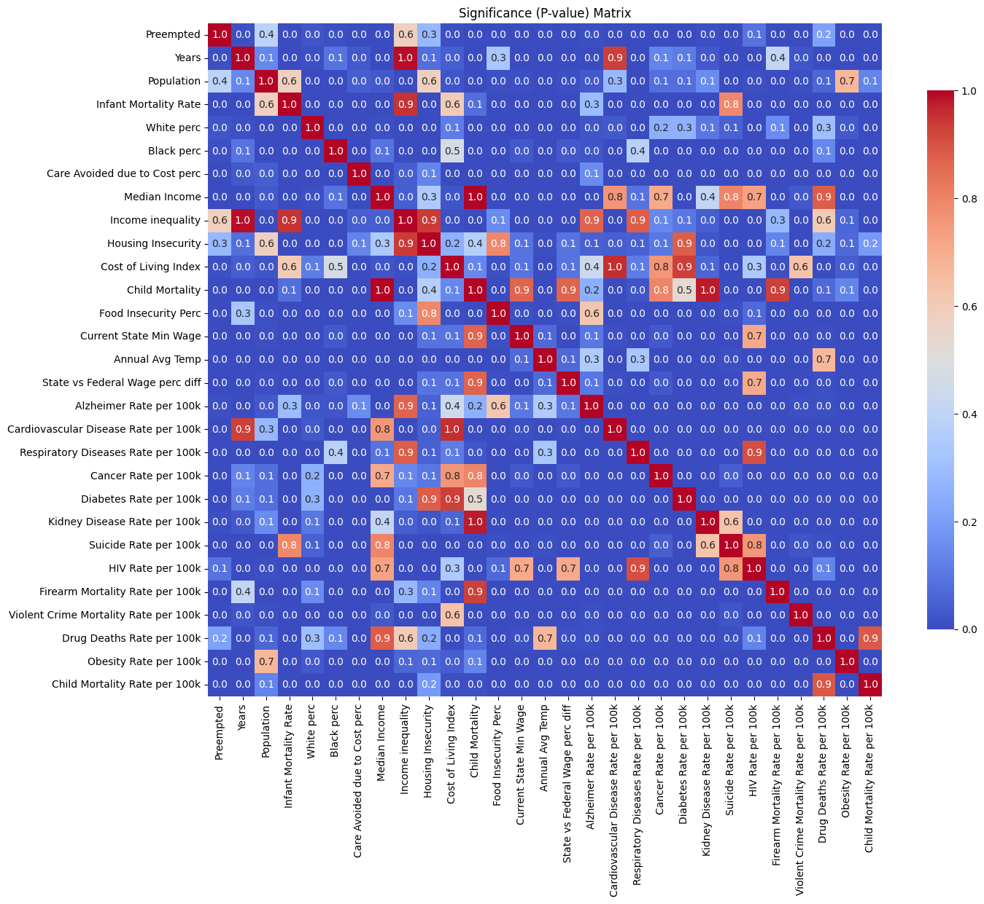
Significance Matrix
This shows the significance of the relationship between two variables.
P-value < 0.05 : No Significant relationship
P-value > 0.05 : Some Significant relationship.
12

Slide 13
Health and Socio-economic Factors
Health Outcomes: Alzheimer Rate per 100k, Cardiovascular Disease Rate per 100k, Respiratory Diseases Rate per 100k, Cancer Rate per 100, Diabetes Rate per 100k, Obesity Rate per 100k, Kidney Disease Rate per 100k, HIV Rate per 100k, Food Insecurity Perc, Infant Mortality Rate, Child Mortality Rate per 100k
Socio-economic Outcomes: Suicide Rate per 100k, Firearm Mortality Rate per 100k, Violent Crime Mortality Rate per 100k, Drug Deaths Rate per 100k, White perc, Black perc, Care Avoided due to Cost perc, Income inequality, Median Income, Cost of Living Index, Food Insecurity Perc, Housing Insecurity, Annual Avg Temp, State vs Federal Wage perc diff
13

Slide 14
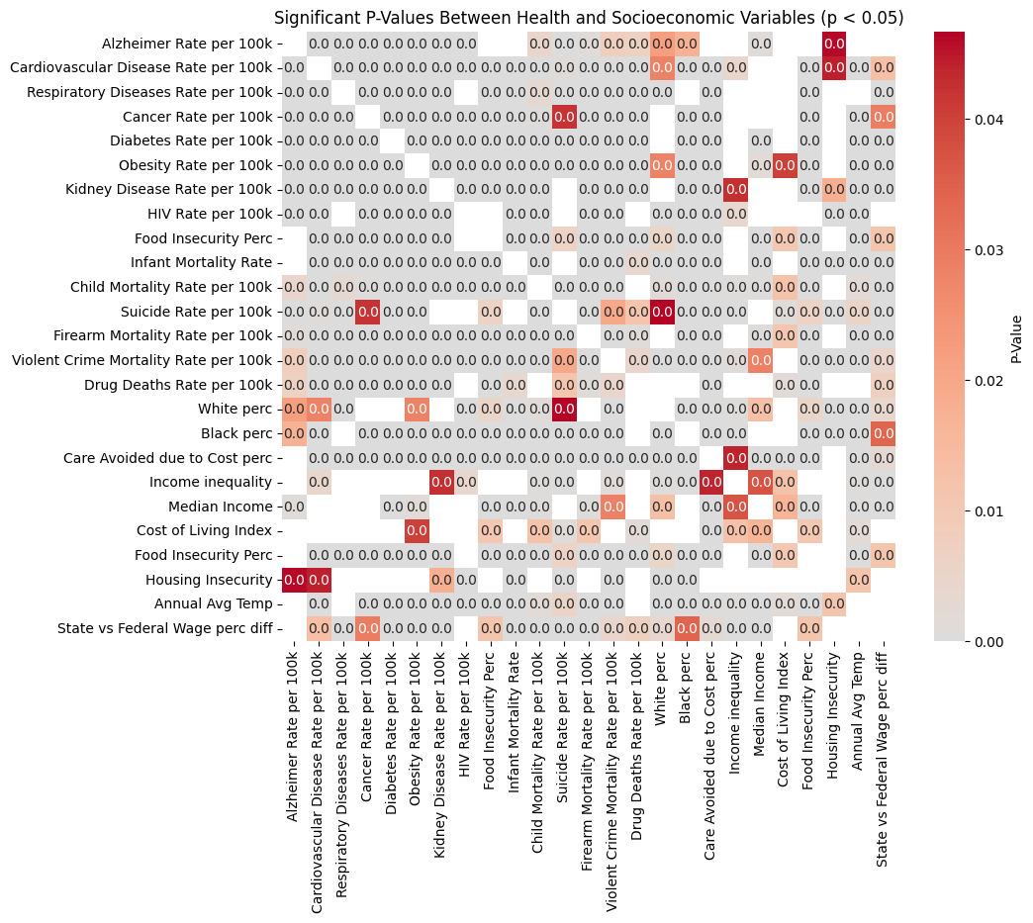
Significance Matrix (Health vs Socio-economic outcomes)
This Significance Matrix only displays the significant relationships between Health outcomes and Socio-economic outcomes.
Any P-value > 0.05 is removed from the matrix.
The 0.0 is just rounding up P-values < 0.05.
14

Slide 15
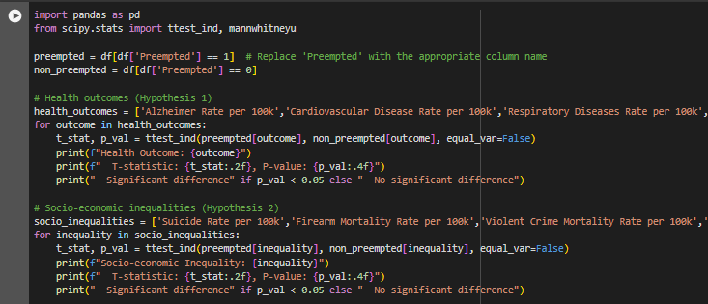
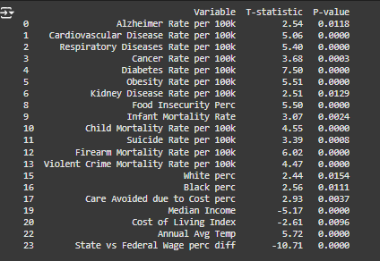
Hypothesis Testing
This hypothesis testing is only to find out if Preemption and Health/Socio-economic outcomes have any sort of relation. It does not describe what sort of relation it is.
15

Slide 16
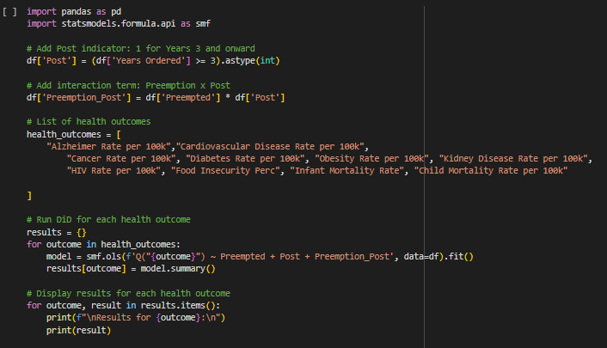
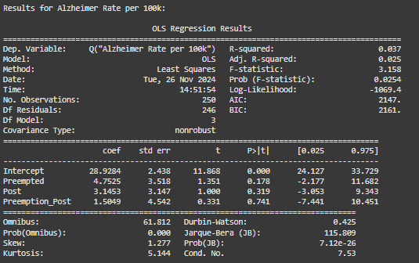
Health Outcomes in Preempted/Non-preempted States
16

Slide 17
Health Outcomes in Preempted/Non-preempted States
Results for Alzheimer Rate per 100k:
Intercept: Coefficient = 28.9284, p-value = 0.0000
Preempted: Coefficient = 4.7525, p-value = 0.1780
Post: Coefficient = 3.1453, p-value = 0.3185
Preemption_Post: Coefficient = 1.5049, p-value = 0.7407
Results for Cardiovascular Disease Rate per 100k:
Intercept: Coefficient = 206.7102, p-value = 0.0000
Preempted: Coefficient = 24.8644, p-value = 0.0063
Post: Coefficient = -8.7136, p-value = 0.2817
Preemption_Post: Coefficient = 7.5725, p-value = 0.5165
Results for Cancer Rate per 100k:
Intercept: Coefficient = 187.8567, p-value = 0.0000
Preempted: Coefficient = 16.4303, p-value = 0.0225
Post: Coefficient = -0.9363, p-value = 0.8838
Preemption_Post: Coefficient = 0.6637, p-value = 0.9428
Results for Diabetes Rate per 100k:
Intercept: Coefficient = 23.5435, p-value = 0.0000
Preempted: Coefficient = 4.1923, p-value = 0.0002
Post: Coefficient = -1.2940, p-value = 0.1986
Preemption_Post: Coefficient = 1.8419, p-value = 0.2048
Results for Obesity Rate per 100k:
Intercept: Coefficient = 5678.0713, p-value = 0.0000
Preempted: Coefficient = 1293.7477, p-value = 0.0010
Post: Coefficient = 360.2366, p-value = 0.3029
Preemption_Post: Coefficient = 179.9310, p-value = 0.7212
Results for Kidney Disease Rate per 100k:
Intercept: Coefficient = 14.8089, p-value = 0.0000
Preempted: Coefficient = 1.8767, p-value = 0.1127
Post: Coefficient = 0.7053, p-value = 0.5042
Preemption_Post: Coefficient = 0.0025, p-value = 0.9987
Results for HIV Rate per 100k:
Intercept: Coefficient = 3.0603, p-value = 0.0000
Preempted: Coefficient = 0.3130, p-value = 0.5976
Post: Coefficient = -0.6097, p-value = 0.2509
Preemption_Post: Coefficient = 0.5256, p-value = 0.4925
Results for Food Insecurity Perc:
Intercept: Coefficient = 10.5154, p-value = 0.0000
Preempted: Coefficient = 2.3742, p-value = 0.0000
Post: Coefficient = 1.2205, p-value = 0.0026
Preemption_Post: Coefficient = -1.3198, p-value = 0.0232
Results for Infant Mortality Rate:
Intercept: Coefficient = 6.6867, p-value = 0.0000
Preempted: Coefficient = 0.2664, p-value = 0.3110
Post: Coefficient = -0.4843, p-value = 0.0401
Preemption_Post: Coefficient = 0.4083, p-value = 0.2293
Results for Child Mortality Rate per 100k:
Intercept: Coefficient = 1.9918, p-value = 0.0000
Preempted: Coefficient = 0.4116, p-value = 0.0185
Post: Coefficient = -0.2312, p-value = 0.1378
Preemption_Post: Coefficient = 0.1541, p-value = 0.4923
Intercept: This is the baseline value of the outcome for non-preempted states in the first 3 years
Preempted: This measures the difference in the outcome between preempted and non-preempted states in the first 3 years.
Post: This measures the difference in the outcome between the post-period and the pre-period for non-preempted states.
Preemption_Post: This measures the additional effect of preemption in the post-period beyond the individual effects of preemption and time.
17

Slide 18
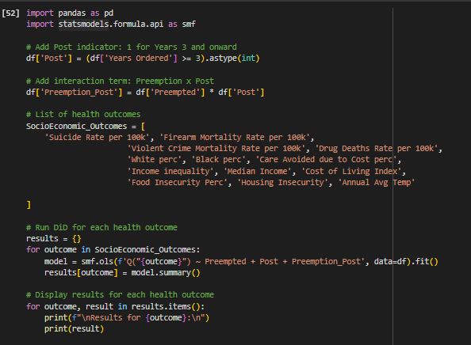
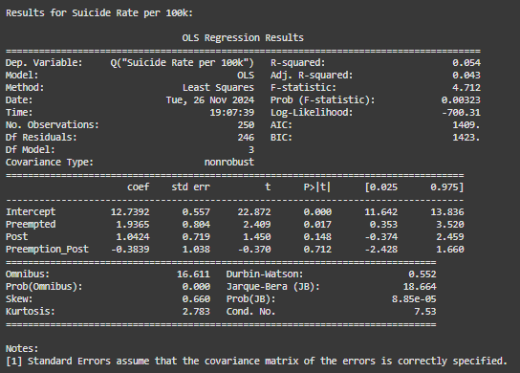
Socio-economic Outcomes in Preempted/Non-preempted States
18

Slide 19
Socio-economic Outcomes in Preempted/Non-preempted States
Results for Suicide Rate per 100k:
Intercept: Coefficient = 12.7392, p-value = 0.0000
Preempted: Coefficient = 1.9365, p-value = 0.0167
Post: Coefficient = 1.0424, p-value = 0.1484
Preemption_Post: Coefficient = -0.3839, p-value = 0.7118
Results for Firearm Mortality Rate per 100k:
Intercept: Coefficient = 9.7914, p-value = 0.0000
Preempted: Coefficient = 3.4735, p-value = 0.0002
Post: Coefficient = 0.4907, p-value = 0.5495
Preemption_Post: Coefficient = 0.0269, p-value = 0.9819
Results for Violent Crime Mortality Rate per 100k:
Intercept: Coefficient = 4.7176, p-value = 0.0000
Preempted: Coefficient = 1.3488, p-value = 0.0244
Post: Coefficient = -0.3024, p-value = 0.5709
Preemption_Post: Coefficient = 0.5863, p-value = 0.4465
Results for Drug Deaths Rate per 100k:
Intercept: Coefficient = 13.4913, p-value = 0.0000
Preempted: Coefficient = 0.4377, p-value = 0.7781
Post: Coefficient = 1.9626, p-value = 0.1585
Preemption_Post: Coefficient = 1.3567, p-value = 0.4988
Results for White perc:
Intercept: Coefficient = 71.1435, p-value = 0.0000
Preempted: Coefficient = 4.6278, p-value = 0.1330
Post: Coefficient = 0.0000, p-value = 1.0000
Preemption_Post: Coefficient = -0.0000, p-value = 1.0000
Results for Black perc:
Intercept: Coefficient = 9.1231, p-value = 0.0000
Preempted: Coefficient = 3.0311, p-value = 0.1082
Post: Coefficient = 0.0000, p-value = 1.0000
Preemption_Post: Coefficient = 0.0000, p-value = 1.0000
Results for Care Avoided due to Cost perc:
Intercept: Coefficient = 12.4000, p-value = 0.0000
Preempted: Coefficient = 2.0083, p-value = 0.0013
Post: Coefficient = 1.1679, p-value = 0.0358
Preemption_Post: Coefficient = -1.4235, p-value = 0.0759
Results for Income inequality:
Intercept: Coefficient = 0.4589, p-value = 0.0000
Preempted: Coefficient = -0.0228, p-value = 0.0151
Post: Coefficient = -0.0199, p-value = 0.0176
Preemption_Post: Coefficient = 0.0326, p-value = 0.0073
Results for Median Income:
Intercept: Coefficient = 49569.0962, p-value = 0.0000
Preempted: Coefficient = -5194.7628, p-value = 0.0006
Post: Coefficient = 1950.5962, p-value = 0.1468
Preemption_Post: Coefficient = 408.3900, p-value = 0.8329
Results for Cost of Living Index:
Intercept: Coefficient = 13.4096, p-value = 0.0000
Preempted: Coefficient = -0.9784, p-value = 0.1043
Post: Coefficient = 0.4006, p-value = 0.4561
Preemption_Post: Coefficient = -0.0319, p-value = 0.9672
Results for Food Insecurity Perc:
Intercept: Coefficient = 10.5154, p-value = 0.0000
Preempted: Coefficient = 2.3742, p-value = 0.0000
Post: Coefficient = 1.2205, p-value = 0.0026
Preemption_Post: Coefficient = -1.3198, p-value = 0.0232
Results for Housing Insecurity:
Intercept: Coefficient = 9.4983, p-value = 0.0000
Preempted: Coefficient = -1.7489, p-value = 0.4901
Post: Coefficient = 0.0271, p-value = 0.9904
Preemption_Post: Coefficient = 0.0593, p-value = 0.9855
Results for Annual Avg Temp:
Intercept: Coefficient = 50.9923, p-value = 0.0000
Preempted: Coefficient = 5.3369, p-value = 0.0014
Post: Coefficient = -0.8141, p-value = 0.5813
Preemption_Post: Coefficient = 1.0460, p-value = 0.6234
Intercept: This is the baseline value of the outcome for non-preempted states in the first 3 years
Preempted: This measures the difference in the outcome between preempted and non-preempted states in the first 3 years.
Post: This measures the difference in the outcome between the post-period and the pre-period for non-preempted states.
Preemption_Post: This measures the additional effect of preemption in the post-period beyond the individual effects of preemption and time.
19

Slide 20
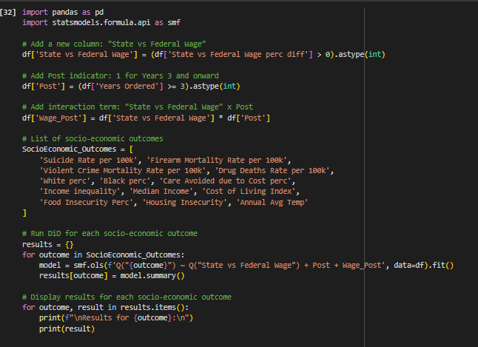
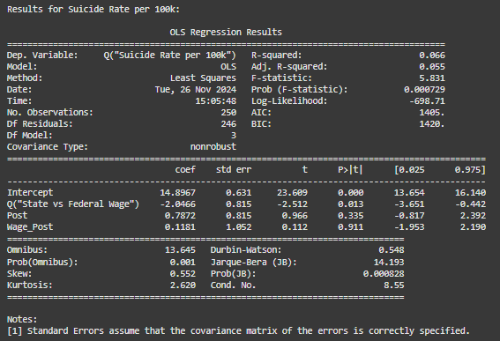
Socio-economic Outcomes in States with higher/equal minimum wage than Federal
20

Slide 21
Socio-economic Outcomes in States with higher/equal minimum wage than Federal
Results for Suicide Rate per 100k:
Intercept: Coefficient = 14.8967, p-value = 0.0000
Q("State vs Federal Wage"): Coefficient = -2.0466, p-value = 0.0126
Post: Coefficient = 0.7872, p-value = 0.3348
Wage_Post: Coefficient = 0.1181, p-value = 0.9106
Results for Firearm Mortality Rate per 100k:
Intercept: Coefficient = 13.5512, p-value = 0.0000
Q("State vs Federal Wage"): Coefficient = -3.4876, p-value = 0.0002
Post: Coefficient = 0.7504, p-value = 0.4186
Wage_Post: Coefficient = -0.4114, p-value = 0.7311
Results for Violent Crime Mortality Rate per 100k:
Intercept: Coefficient = 5.9177, p-value = 0.0000
Q("State vs Federal Wage"): Coefficient = -0.9211, p-value = 0.1384
Post: Coefficient = 0.3028, p-value = 0.6256
Wage_Post: Coefficient = -0.5395, p-value = 0.5007
Results for Drug Deaths Rate per 100k:
Intercept: Coefficient = 14.4760, p-value = 0.0000
Q("State vs Federal Wage"): Coefficient = -1.2911, p-value = 0.4159
Post: Coefficient = 2.5255, p-value = 0.1122
Wage_Post: Coefficient = 0.1472, p-value = 0.9427
Results for White perc:
Intercept: Coefficient = 76.5105, p-value = 0.0000
Q("State vs Federal Wage"): Coefficient = -5.2428, p-value = 0.0944
Post: Coefficient = 0.0000, p-value = 1.0000
Wage_Post: Coefficient = 0.0000, p-value = 1.0000
Results for Black perc:
Intercept: Coefficient = 13.1400, p-value = 0.0000
Q("State vs Federal Wage"): Coefficient = -4.2700, p-value = 0.0251
Post: Coefficient = -0.0000, p-value = 1.0000
Wage_Post: Coefficient = 0.0000, p-value = 1.0000
Results for Care Avoided due to Cost perc:
Intercept: Coefficient = 14.2100, p-value = 0.0000
Q("State vs Federal Wage"): Coefficient = -1.4100, p-value = 0.0282
Post: Coefficient = -0.1117, p-value = 0.8614
Wage_Post: Coefficient = 0.9939, p-value = 0.2292
Results for Income inequality:
Intercept: Coefficient = 0.4265, p-value = 0.0000
Q("State vs Federal Wage"): Coefficient = 0.0357, p-value = 0.0002
Post: Coefficient = 0.0112, p-value = 0.2328
Wage_Post: Coefficient = -0.0258, p-value = 0.0335
Results for Median Income:
Intercept: Coefficient = 45647.5500, p-value = 0.0000
Q("State vs Federal Wage"): Coefficient = 2380.1000, p-value = 0.1365
Post: Coefficient = 2190.3667, p-value = 0.1704
Wage_Post: Coefficient = -72.9056, p-value = 0.9718
Results for Cost of Living Index:
Intercept: Coefficient = 13.4650, p-value = 0.0000
Q("State vs Federal Wage"): Coefficient = -0.8750, p-value = 0.1556
Post: Coefficient = 0.3750, p-value = 0.5422
Wage_Post: Coefficient = 0.0172, p-value = 0.9827
Results for Food Insecurity Perc:
Intercept: Coefficient = 12.4025, p-value = 0.0000
Q("State vs Federal Wage"): Coefficient = -1.2458, p-value = 0.0103
Post: Coefficient = 0.0742, p-value = 0.8778
Wage_Post: Coefficient = 0.8547, p-value = 0.1705
Results for Housing Insecurity:
Intercept: Coefficient = 7.8797, p-value = 0.0001
Q("State vs Federal Wage"): Coefficient = 1.2984, p-value = 0.6157
Post: Coefficient = 0.1668, p-value = 0.9486
Wage_Post: Coefficient = -0.1853, p-value = 0.9558
Results for Annual Avg Temp:
Intercept: Coefficient = 55.0250, p-value = 0.0000
Q("State vs Federal Wage"): Coefficient = -2.4517, p-value = 0.1667
Post: Coefficient = 0.0233, p-value = 0.9895
Wage_Post: Coefficient = -0.5589, p-value = 0.8067
Intercept: It is the expected value of the outcome in states where the state and federal minimum wage are equal in the first 3 years.
Q("State vs Federal Wage"): This coefficient captures the average difference in the outcome variable between states with a positive difference in "State vs Federal Wage" and states with equal wage, during the first 3 years.
Post: This coefficient represents the average change in the outcome variable across all states in the last 2 years.
Wage_Post: This interaction term represents the additional effect on the outcome variable for states with minimum wage higher than federal wage.
21

Slide 22
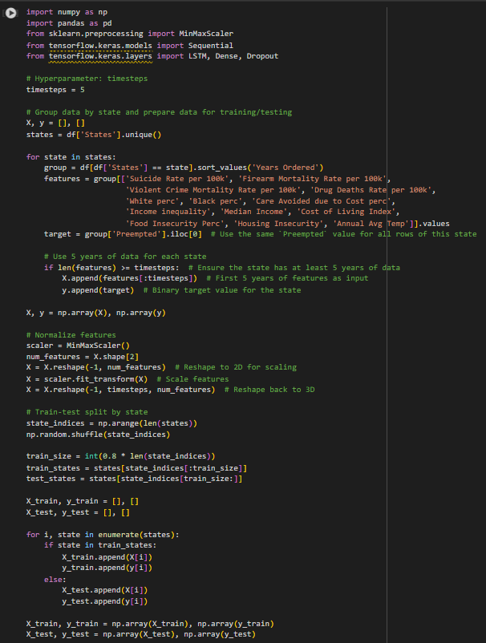
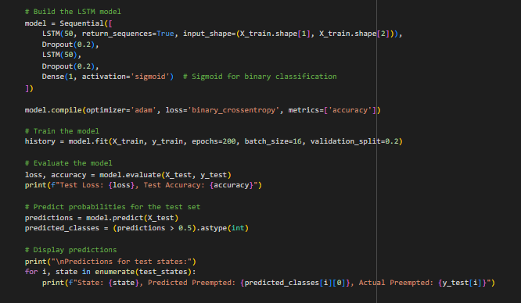
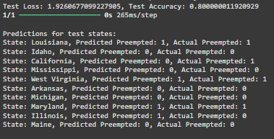
LSTM model for Socio-economic factors
22

Slide 23
References
https://www.macrotrends.net/global-metrics/states/utah/population
https://www.alz.org/alzheimers-dementia/facts-figures
https://healthy.arkansas.gov/wp-content/uploads/lead_2015_closed.pdf#:~:text=2015%20Alzheimer
https://health.alaska.gov/dph/VitalStats/Documents/PDFs/2006/2006_Death_web.pdf
https://www.cdph.ca.gov/Programs/CHSI/CDPH%20Document%20Library/Alzheimer%20DDTS%20Document%20Final.pdf
https://www.cdph.ca.gov/Programs/CCDPHP/DCDIC/CDCB/Pages/AlzheimersDataStatisticsReports.aspx
https://www.cohealthdata.dphe.state.co.us/chd/Resources/vs/2009/Colorado.pdf
https://dhss.delaware.gov/dph/hp/files/ar2009.pdf
https://oasis.state.ga.us/oasis/webquery/qryADRDMortality.aspx
https://health.hawaii.gov/vitalstatistics/
https://publicdocuments.dhw.idaho.gov/WebLink/Browse.aspx?id=11605&dbid=0&repo=PUBLIC-DOCUMENTS
https://dph.illinois.gov/data-statistics/vital-statistics/death-statistics.html
https://www.in.gov/health/reports/mortality/2009/highlights.htm
https://www.kdhe.ks.gov/1820/Kansas-Vital-Statistics-at-a-Glance
https://publications.iowa.gov/39296/1/vital_stats_2019_brief-20200409.pdf
https://www.courier-journal.com/story/health-bytes/2015/03/27/2015-alzheimers-report-shows-deaths-on-the-rise-and-disclosure-rate-low/70533064/
23

Slide 24
References
https://www.maine.gov/dhhs/mecdc/public-health-systems/data-research/data/documents/2020%20Mortality%20Report%20Final%20071722.pdf
https://www.mdch.state.mi.us/osr/CRI/Alzheimers.asp
https://minnesotareformer.com/2023/10/10/the-pandemic-changed-how-minnesotans-die/
https://msdh.ms.gov/phs/2007/Summary/dthst07.pdf
https://dhhs.ne.gov/Reports/Vital%20Statistics%20Report%202010.pdf
https://www-doh.nj.gov/doh-shad/indicator/view/AlzDeath.Trend.html?PrinterFriendly=x
https://www.nyc.gov/assets/doh/downloads/pdf/vs/2007sum.pdf
https://ibis.doh.nm.gov/query/result/mort/MortCnty/Count.html
https://app.powerbigov.us/view?r=eyJrIjoiZjI3N2ZhOGItNWFmYS00NzE0LWFlZGMtN2ZhZDIxNTFhNzlmIiwidCI6IjJkZWEwNDY0LWRhNTEtNGE4OC1iYWUyLWIzZGI5NGJjMGM1NCJ9&pageName=ReportSectiona726e088257f0d4315b8
https://odh.ohio.gov/wps/wcm/connect/gov/0ee853f1-e546-4fdd-9422-3c0b055984e1/Cognitive+Decline+and++Dementia+in+Ohio_Final.pdf?MOD=AJPERES
https://www.health.state.ok.us/stats/Vital_Statistics/Death/Final/Tables.shtml
https://www.pa.gov/content/dam/copapwp-pagov/en/health/documents/topics/healthstatistics/vitalstatistics/countyhealthprofiles/documents/County_Health_Profiles_2008.pdf
https://sc.edu/study/colleges_schools/public_health/documents/alzheimers_registry_report.pdf
https://doh.sd.gov/media/ngfhbvum/sd_mortality_2004-2020.pdf
24

Slide 25
References
https://www.tn.gov/health/health-program-areas/statistics/health-data/death-statistics.html
https://www.dshs.texas.gov/alzheimers-disease/alzheimers-disease-statistics
https://ibis.utah.gov/ibisph-view/indicator/complete_profile/AlzDea.html
https://www.cdc.gov/nchs/data/databriefs/db116.pdf
https://apps.vdh.virginia.gov/HealthStats/stats.htm
https://www.bing.com/ck/a?!&&p=1dd674930cd96d6aJmltdHM9MTcyNjUzMTIwMCZpZ3VpZD0xOGUxN2ZiMy1iODQ2LTY0N2YtMzhmMy02YjEyYjkzMzY1MTUmaW5zaWQ9NTIwMA&ptn=3&ver=2&hsh=3&fclid=18e17fb3-b846-647f-38f3-6b12b9336515&psq=west+virginia+vital+statistics+2007+wvdhhr&u=a1aHR0cHM6Ly93d3cud3ZkaGhyLm9yZy9icGgvaHNjL3B1YnMvdml0YWwvMjAwNy8yMDA3Vml0YWwucGRm&ntb=1
https://deadorkicking.com/death-statistics/us/
https://www.americashealthrankings.org/explore/measures/costburden_women/MD
https://www.census.gov/library/stories/2021/08/improved-race-ethnicity-measures-reveal-united-states-population-much-more-multiracial.html
https://en.wikipedia.org/wiki/Demographics_of_the_United_States
https://usafacts.org/data/topics/people-society/population-and-demographics/our-changing-population/
https://en.wikipedia.org/wiki/White_Americans
https://www.pewresearch.org/social-trends/fact-sheet/facts-about-the-us-black-population/
https://blackdemographics.com/population/black-state-population/
Surveillance - United States Diabetes Surveillance System (cdc.gov)
https://wid.world/data/
https://evictionlab.org/map/?m=modeled&c=p&b=efr&s=all&r=states&y=2015&z=2.76&lat=41.32&lon=-106.33&lang=en
25

Slide 26

Questions?
26

